Slide 1
Gas Laws
More to a gas then you think…

Slide 2
Remember the Kinetic Molecular Theory (KMT)
Particles in an ideal gas… (ideal means perfect)
  Have no volume
  Have elastic collisions (they just keep going… and going… and going…)
  Are in constant, random, straight-line motion
  Don’t attract or repel each other
  Have an average kinetic energy directly related to the Kelvin temperature (one increases, so does the other)

Slide 3
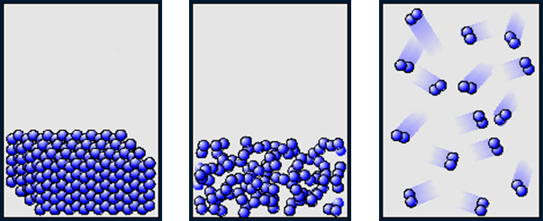
Remember Gases
Gases expand to fill any container
  Random motion, no attraction
Gases are fluids (they keep moving!) (fluid does not mean liquid!)
  No attraction
Gases have very low densities
  No volume = lots of empty space

Slide 4
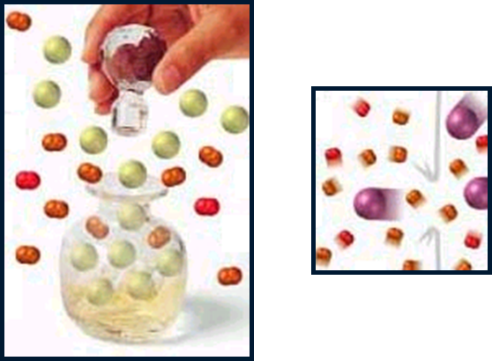
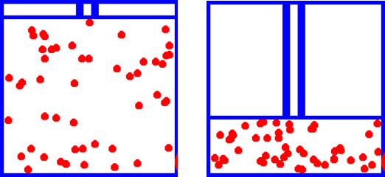
Remember Gases
Gases can be compressed
  No volume = lots of empty space
Gases undergo diffusion and effusion
  Diffusion is like perfume or a fart—the smell will travel to a less densely populated area (those smells SPREAD)
  Effusion is like a balloon deflating—the gas particles escape out of tiny holes (like helium leaking out of the holes in balloon latex)

Slide 5
Physical Characteristics of Gases
Physical Characteristics | Typical Units
Volume, V | liters (L)
Pressure, P | atmosphere (1 atm = 1.015x10⁵ N/m²)
Temperature, T | Kelvin (K)
Number of atoms or molecules, n | mole (1 mol = 6.022x10²³ atoms or molecules)

Slide 6
So What About Pressure?
Pressure measures the amount of force in a specific area
When we talk about pressure caused by gases, we mean how much force combined particles are putting on YOU and other objects

Slide 7
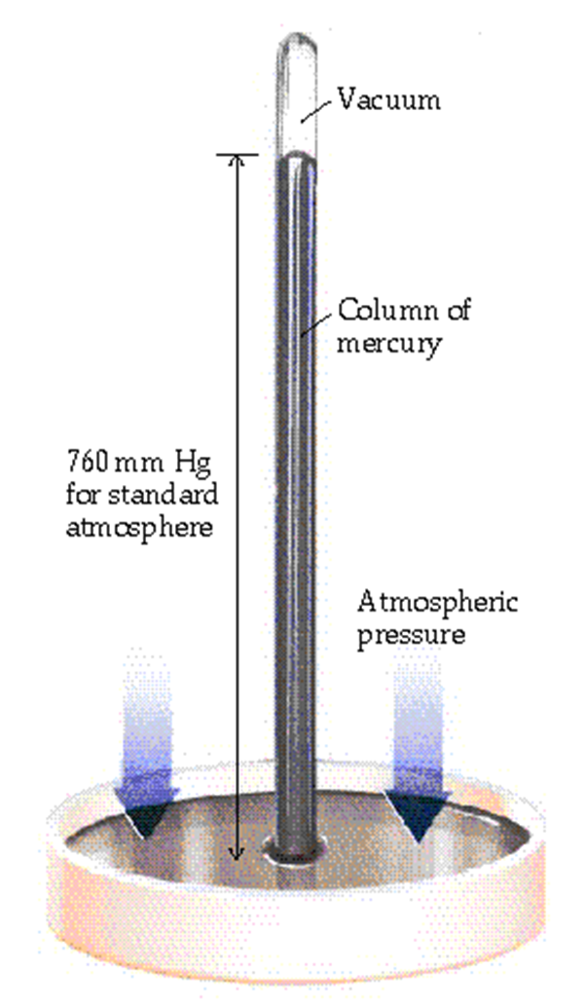
Measuring Pressure
Barometer
  measures atmospheric pressure
Developed by Torricelli in 1643
Particles in the atmosphere push down on
the mercury in the dish causing it to rise in the
tube
The height of the mercury in the tube is the
atmospheric pressure

Slide 8
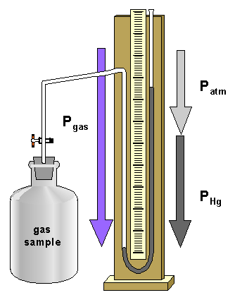
Measuring Pressure
Manometer (ba-ba-ba-da-da)
  The original “u”-tube
  Measures contained gas pressure
A gas sample is attached to one
end of a u-tube
The other end is open
The difference between the
atmospheric side and sample side
Is the pressure of your gas

Slide 9
Key Units at Sea Level
101.325 kPa (kilopascal)
1 atm (atmosphere)
760 mm Hg (millimeters of mercury)
760 torr (Torricelli was a scientist!)
14.7 psi (pounds per square inch)

Slide 10
What is STP?
No, it’s not the Stone Temple Pilots
STP in chemistry allows us to compare amounts of gases between different pressures and temperatures
Standard temperature and pressure
  0 degrees Celsius and 1 atm

Slide 11
On to the gas laws….

Slide 12
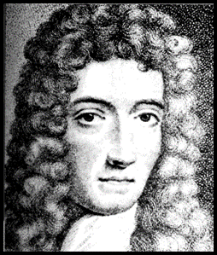
Boyle’s Law
The pressure and volume of a gas are INVERSELY related
  At constant mass and temperature
This means when one increases, the other decreases
P1V1 = P2V2
Increase pressure, decrease volume
Increase volume, decrease pressure
P
V

Slide 13
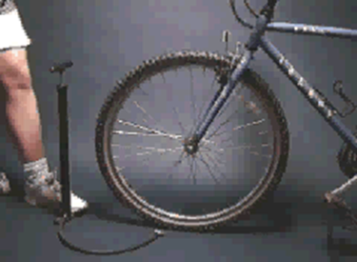
Boyle’s Law Example
A bicycle pump
As the volume of the air trapped in the pump is reduced, its pressure goes up, and air is forced into the tire

Slide 14
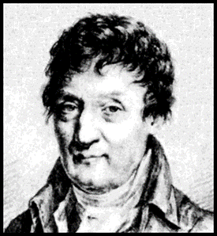
Charles’ Law
The volume and absolute temperature (K) of a gas are DIRECTLY related
  At constant mass and pressure
This means when one increases, so does the other
V1/T1 = V2/T2
Increase volume, increase temperature
Decrease volume, decrease temperature
V
T

Slide 15
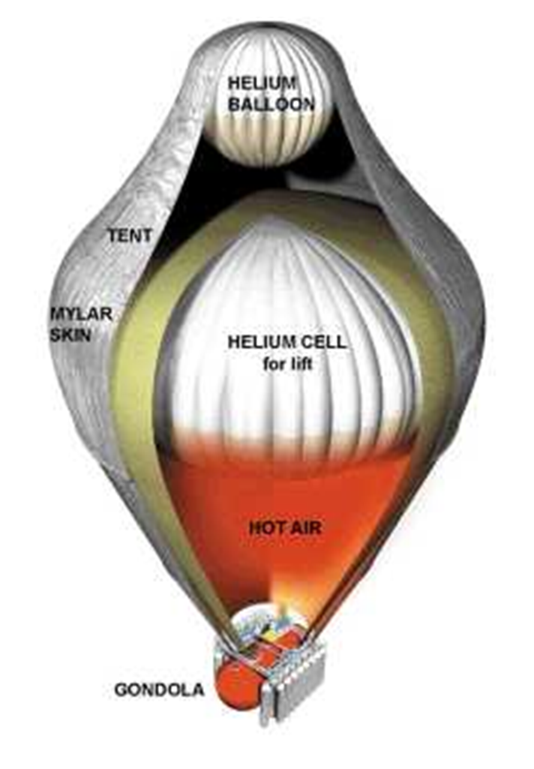
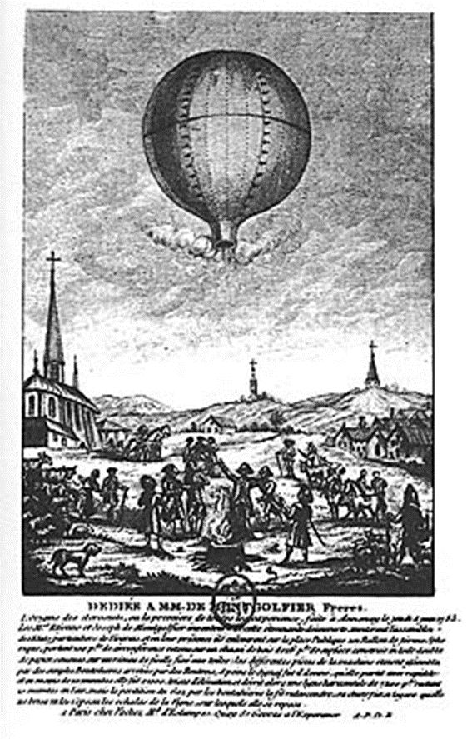
Charles was a Balloonist!
Charles’s original balloon
Modern long-distance balloon

Slide 16
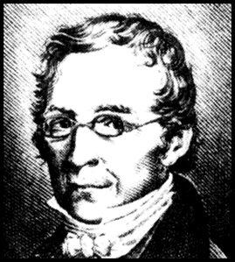
Gay-Lussac’s Law (that was really his name!)
The pressure and absolute temperature (K) of a gas are DIRECTLY related
  At constant mass and volume
This means when one increases, so does the other
P1/T1 = P2/T2
Increase pressure, increase temperature
Decrease pressure, decrease temperature
P
T

Slide 17
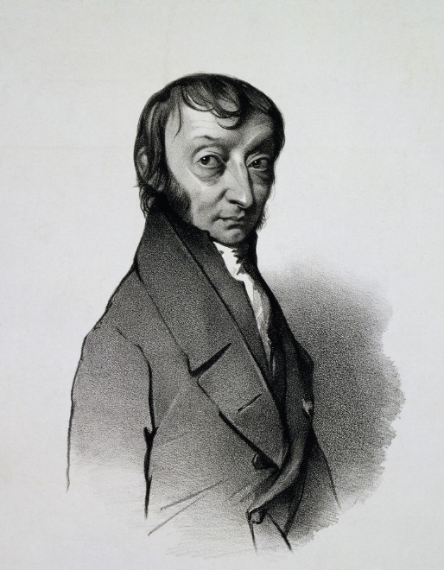
Avogadro’s Law
The volume and moles (or amount) of a gas are DIRECTLY related
  At constant temperature (K) and pressure
This means when one increases, so does the other
V1/n1 = V2/n2
Increase volume, increase
Moles
Decrease volume, decrease
moles
twice as many molecules

Slide 18
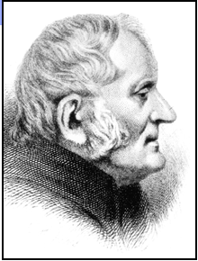
Dalton’s Law of Partial Pressures
Exactly what it sounds like
If you add up the pressure of each INDIVIDUAL gas in a sample, the total will be the pressure in the container
Ptotal = P1 + P2 + P3 + P4 + …
YouTube - Crash Course - Partial Pressures

Slide 19
Graham’s Law
Graham’s law governs effusion and diffusion of gas molecules
The rate of effusion is INVERSELY proportional to it’s molar mass (or size)
The bigger the particle, the slower it moves
The smaller the particle, the faster it moves
YouTube - Crash Course - Passing Gases

Slide 20
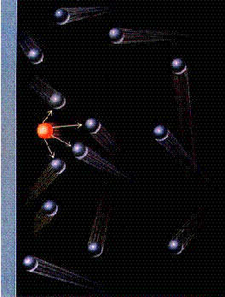
But in Real Life…
Real molecules have VOLUME
  So they aren’t actually a volume of 0
There are also INTERMOLECULAR FORCES
  So there really is attraction between particles
A real gas is most like an ideal gas at LOW
PRESSURE and HIGH TEMPERATURE
Gases that act the most ideal are the smallest
  Hydrogen and helium

Slide 21
Differences Between Ideal and Real Gases
Ideal Gas
Real Gas
Obey PV=nRT | Always | Only at very low P and high T
Molecular volume | Zero | Small but nonzero
Molecular attractions | Zero | Small
Molecular repulsions | Zero | Small
YouTube - Crash Course - Real Gases

Slide 22
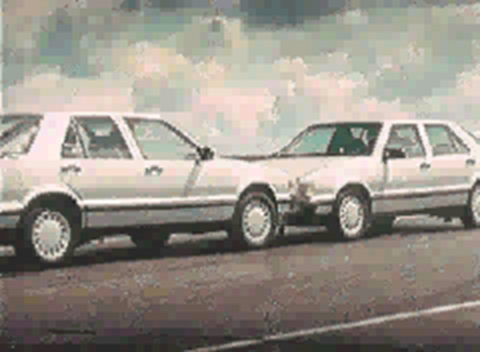
Why are Gases Important?
Airbags fill with nitrogen gas in an accident
Hot air balloons fly by use of gases
Your tire pressure depends on gases
If a scuba diver comes up to quickly, the nitrogen gas will form bubbles in the blood, a painful and dangerous condition (called “the bends”)

Slide 23
YouTube - MythBusters - Fun With Gas
YouTube - Veritasium - Seeing the Invisible
YoutTube - VSauce - Fart Science

